Slide 1
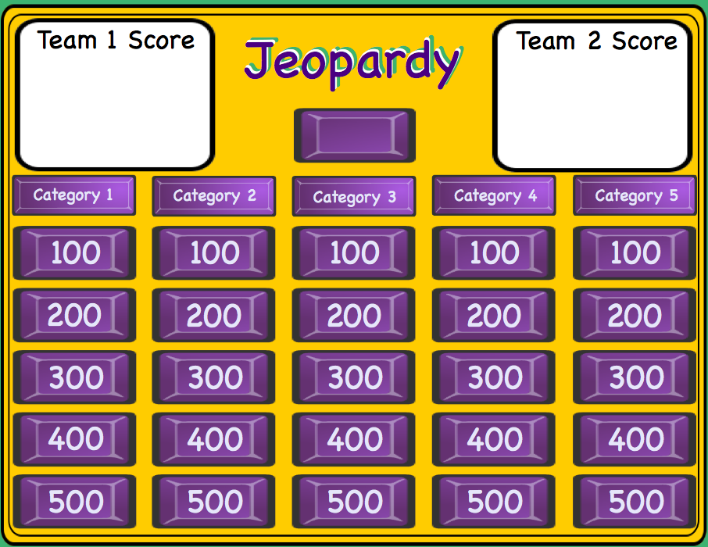
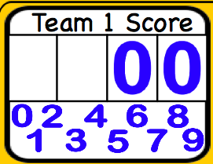
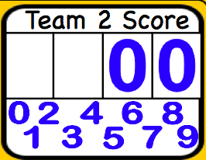
Smartboard Jeopardy
Smartboard Jeopardy
Lesson notes
Lesson notes
L. Harvey Almarode
Instructor
L. Harvey Almarode
Instructor
Memorial Hall 3625D
MSC 6907
Harrisonburg, VA 22807
540-568-4550
almarolh@jmu.edu
almarolh.googlepages.com

Slide 2
Lesson Notes
Lesson Notes
Directions for using this Smartboard Jeopardy template.
Double click on the Category names to edit and change.
Edit each of the Question pages with the Question and Answer. You must move the purple reveal box to enter the correct response, then move the reveal box over the answer until it is covered. After all questions are entered Save As ... and give it another name. This helps preserve the template.
The blank purple button in the center of the Jeopardy board is an Infinite Cloner and is used to place over the question button when you return to the Jeopardy Board. This shows that this button has been chosen and can not be chosen again.
The white cells are for the score keeper to keep score of the teams. Drag the numbers to the cell to change score. Drag the white rectangle to the cell to delete score.
Jeopardy Board

Slide 3
Team 1 Score
Jeopardy
Team 2 Score
Jeopardy
Jeopardy
Polygons
Trig
Coordinate Geo
Proofs
Triangles II
100
100
100
100
100
200
200
200
200
200
300
300
300
300
300
400
400
400
400
400
500
500
500
500
500

Slide 4
Category 1 - 100
Find the interior angle sum
1080°
Jeopardy Board
move to reveal
move to reveal

Slide 5
Category 1 - 200
6
Find the area of the parallelogram
5
4
24
Jeopardy Board
move to reveal
move to reveal

Slide 6
Category 1 - 300
What is the measure of one interior angle of a regular heptagon?
128.6°
Jeopardy Board
move to reveal
move to reveal

Slide 7
Category 1 - 400
Find AB if E and F are the midpoints of the legs.
A
B
E
15
F
D
26
C
4
Jeopardy Board
move to reveal
move to reveal

Slide 8
Category 1 - 500
If angle ADC=3x+10
and angle ABC=5x-30,
what is the measure of angle BCD?
A
B
E
D
C
110 °
Jeopardy Board
move to reveal
move to reveal

Slide 9
Category 2 - 100
What is the value of c?
6
c
6
6√2
move to reveal
Jeopardy Board
move to reveal

Slide 10
Category 2 - 200
Find the value of x.
2
x
5
21.8 °
Jeopardy Board
move to reveal
move to reveal

Slide 11
Category 2 - 300
What is the value of c?
82 °
3
5
c
5.46
Jeopardy Board
move to reveal
move to reveal

Slide 12
Category 2 - 400
13
6
117 °
x
y
Find the value of x and y.
x=24.28 °
y=9.13
Jeopardy Board
move to reveal
move to reveal

Slide 13
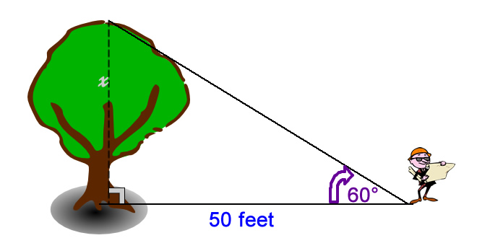
Category 2 - 500
Find x
x = 86.6
Jeopardy Board
move to reveal
move to reveal

Slide 14
Category 3 - 100
Do the following coordinates create a triangle? R(1,-4), S(-3,-20), T(5,12)
^{no RS+RT=ST}
move to reveal
Jeopardy Board
move to reveal

Slide 15
Category 3 - 200
y=4x+2, Find a parallel line to this equation that goes through (-2,6)
y=4x+14
move to reveal
Jeopardy Board
move to reveal

Slide 16
Category 3 - 300
Find the missing coordinates.
(b,c)
(?,?)
(0,0)
(a,0)
(a+b,c)
move to reveal
Jeopardy Board
move to reveal

Slide 17
Category 3 - 400
Determine most specific name of the shape created by the following points:
E(1,5) F(6,5) G(6,10) H(1,10)
Square
move to reveal
Jeopardy Board
move to reveal

Slide 18
Category 3 - 500
Find the distance between the parallel lines
y = 2x+2
y = 2x-3
√5
move to reveal
Jeopardy Board
move to reveal

Slide 19
Category 4 - 100
State the property that justifies the statement.
If 2(x-3), then 2x-6
Distributive
move to reveal
Jeopardy Board
move to reveal

Slide 20
Category 4 - 200
Name the postulate or theorem.
If AB + BC = AC, then B is between A and C.
Segment addition Postulate
move to reveal
Jeopardy Board
move to reveal

Slide 21
Category 4 - 300
Given: <1 and <2 are supplementary
<3 and <4 are supplementary
<1 ≅ <4
4
3
1
2
Fill in the blank.
Prove: <2 ≅ <3
Statement
Reasons
<1 and <2 are supplementary
<3 and <4 are supplementary
<1 ≅ <4
Given
1.
2.
3.
4.
5.
6.
1.
2.
3.
4.
5.
6.
m<1 +m<2 =180
?
m<4 +m<3 =180
Def. of ≅ <'s
m<1 = m<4
m<1 +m<2 = m<3 +m<4
Substitution
m<2 = m<3
Subtraction
<2 ≅ <3
Def. of ≅ <'s
Jeopardy Board

Slide 22
Category 4 - 400
Write the contrapostive of: If you are a teenager, then you are at least 13 years old.
If you are not at least 13 years old, then you are not a teenager.
move to reveal
Jeopardy Board
move to reveal

Slide 23
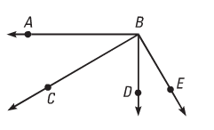
Category 4 - 500
Fill in the blanks.
Statements Reasons
1)
2)
3)
4)
5)
6)
7.)
<ABD is a rt. <.
<CBE is a rt. <
1)
2)
3)
4)
5)
6)
7.)
?
m<ABD= 90
m<CBE = 90
def. of rt.<
m<ABD =m<CBE
?
m<ABC + m<CBD =m<ABD
m<CBD + m<DBE =m<CBE
< Addition Postulate
m<ABC + m<CBD = m<CBD + m<DBE
Substitution
m<ABC = m<DBE
?
<ABC ≅ <DBE
Jeopardy Board
Def. of ≅ <'s

Slide 24
Category 5 - 100
Find x.
x
35
110
75 °
Jeopardy Board
move to reveal
move to reveal

Slide 25
Category 5 - 200
P
Find m<PSR
15x+42 °
Q
10x-7
S
5x+3
R
72 °
Jeopardy Board
move to reveal
move to reveal

Slide 26
Category 5 - 300
Find the value of x
4x-6
x+7
2x-15
24
Jeopardy Board
move to reveal
move to reveal

Slide 27
Category 5 - 400
1
List all angles that measure less than angle 8.
2
3
7
4
6
5
8
Angles 4, 6, 2, and 7
move to reveal
Jeopardy Board
move to reveal

Slide 28
Category 5 - 500
Find the area of the triangle.
Hint: Herron's Formula
A=√(s(s-a)(s-b)(s-c))
s=1/2p
6
7
9
20.98
move to reveal
Jeopardy Board
move to reveal

