Slide 1
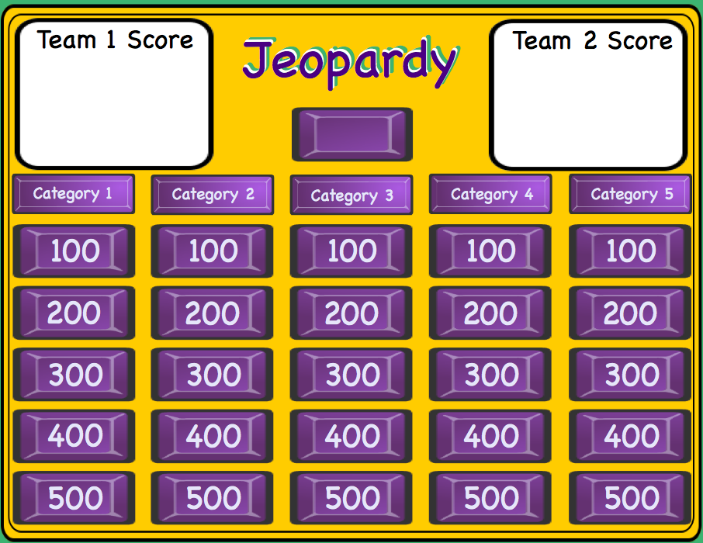
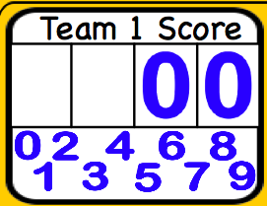
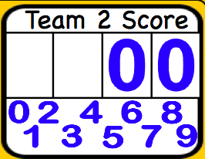
Smartboard Jeopardy
Smartboard Jeopardy
Lesson notes
Lesson notes
L. Harvey Almarode
Instructor
L. Harvey Almarode
Instructor
Memorial Hall 3625D
MSC 6907
Harrisonburg, VA 22807
540-568-4550
almarolh@jmu.edu
almarolh.googlepages.com

Slide 2
Lesson Notes
Lesson Notes
Directions for using this Smartboard Jeopardy template.
Double click on the Category names to edit and change.
Edit each of the Question pages with the Question and Answer. You must move the purple reveal box to enter the correct response, then move the reveal box over the answer until it is covered. After all questions are entered Save As ... and give it another name. This helps preserve the template.
The blank purple button in the center of the Jeopardy board is an Infinite Cloner and is used to place over the question button when you return to the Jeopardy Board. This shows that this button has been chosen and can not be chosen again.
The white cells are for the score keeper to keep score of the teams. Drag the numbers to the cell to change score. Drag the white rectangle to the cell to delete score.
Jeopardy Board

Slide 3
Team 1 Score
Jeopardy
Team 2 Score
Jeopardy
Jeopardy
Basics
Parallel Lines
Triangles
Similar Triangles
Circles
100
100
100
100
100
200
200
200
200
200
300
300
300
300
300
400
400
400
400
400
500
500
500
500
500

Slide 4
Category 1 - 100
Given points (3,6) and (-5,8), find the midpoint of the line segment.
(-1,7)
move to reveal
move to reveal
Jeopardy Board

Slide 5
Category 1 - 200
3x-2
43°
Solve for x.
x=15
Jeopardy Board
move to reveal
move to reveal

Slide 6
Category 1 - 300
Solve for x.
2x-8
3x+3
x=19
Jeopardy Board
move to reveal
move to reveal

Slide 7
Category 1 - 400
Find the distance from (7,9) to (-3,-1).
√200≈14.14
Jeopardy Board
move to reveal
move to reveal

Slide 8
Category 1 - 500
Find the length and end point of a line whose midpoint is (1,2) and has one endpoint of (5,6).
(-3,-2)
d=11.31
move to reveal
Jeopardy Board
move to reveal

Slide 9
Category 2 - 100
w
m
n
Name the transversal.
w
Jeopardy Board
move to reveal
move to reveal

Slide 10
Category 2 - 200
1
2
3
4
5
6
7
8
Name a pair of alternate interior angles.
Angles 3 and 6
or
Angles 4 and 5
Jeopardy Board
move to reveal
move to reveal

Slide 11
Category 2 - 300
1
65°
3
4
5
6
7
8
What is the measure of angle 5?
115°
Jeopardy Board
move to reveal
move to reveal

Slide 12
Category 2 - 400
1
2
3
3x+2
5
6
2x-7
8
Find the measure of angle 5.
113°
Jeopardy Board
move to reveal
move to reveal

Slide 13
Category 2 - 500
1
2
11
10
3
4
9
7
8
6
5
Name a pair of alternate interior angles that are not congruent.
Angles 11 and 4
Jeopardy Board
move to reveal
move to reveal

Slide 14
Category 3 - 100
27°
83°
Find the missing angle measure.
70°
Jeopardy Board
move to reveal
move to reveal

Slide 15
Category 3 - 200
These 2 triangles are congruent by which theorem or postulate?
SAS
Jeopardy Board
move to reveal
move to reveal

Slide 16
Category 3 - 300
Solve for x.
5x-6°
2x+9°
x=5
Jeopardy Board
move to reveal
move to reveal

Slide 17
Category 3 - 400
B
Triangle ABC is isosceles with Vertex B.
Find the measure of the base.
4x+5
3x+20
A
C
2x+4
AC = 34
Jeopardy Board
move to reveal
move to reveal

Slide 18
Category 3 - 500
Which set of sides does not form a triangle?
3,4,5 4,12,17
2,2,1 0.6,0.7,1
4,12,17
Jeopardy Board
move to reveal
move to reveal

Slide 19
What is the scale factor from ABC to DEF?
Category 4 - 100
B
E
2
6
~
18
6
A
4
C
D
12
F
1/3
Jeopardy Board
move to reveal
move to reveal

Slide 20
Category 4 - 200
What is the value of x?
B
E
3
5
~
6
A
4
C
D
x
F
x=8
Jeopardy Board
move to reveal
move to reveal

Slide 21
Category 4 - 300
Solve for x.
2x+2
8
3
3
x=3
move to reveal
Jeopardy Board
move to reveal

Slide 22
Category 4 - 400
Solve for y.
8
8
y
4
4
18
y=12
Jeopardy Board
move to reveal
move to reveal

Slide 23
Category 4 - 500
Are these triangles similar?
72°
56°
56°
53°
No
Jeopardy Board
move to reveal
move to reveal

Slide 24
Category 5 - 100
AB is a diameter. Find the exact circumference.
A
8
B
8π
Jeopardy Board
move to reveal
move to reveal

Slide 25
Category 5 - 200
Find the value of z.
z°
172°
z = 86°
Jeopardy Board
move to reveal
move to reveal

Slide 26
Category 5 - 300
25°
g°
Find the value of g.
11°
26°
g=20°
Jeopardy Board
move to reveal
move to reveal

Slide 27
Category 5 - 400
y
Write an equation for the given circle.
5
x
5
(x+4)2+(y-2)2=16
Jeopardy Board
move to reveal
move to reveal

Slide 28
Category 5 - 500
If chord AB is 2 units from the center what is the radius of the circle?
A
6
B
√13≈3.61
Jeopardy Board
move to reveal
move to reveal

